Slide 1
EMOTION DETECTION USING HAPTICS AND FACE EXPRESSION
Team – 3, HAPTICS RECOGNIZERS
Team Members
ARCHITA ARUN
CHARAN RAJU
P SAI CHARAN
SHREYA SALLA PANKAJ
VENKATA KARTHIK DODDA

Slide 2
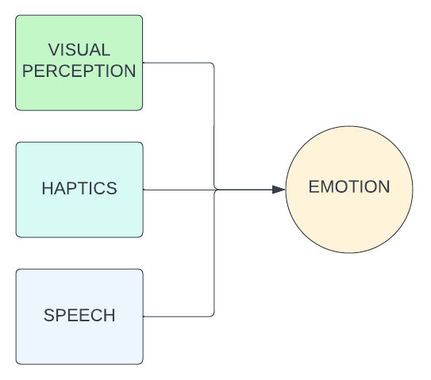
INTRODUCTION
Emotion detection solely does not depend on face expression
Haptics and speech also contribute for emotion recognition
This concept can be used to improve social assistant robots and robotic pets
This helps to develop emotional intelligence in Robots
SHREYA SALLA PANKAJ

Slide 3
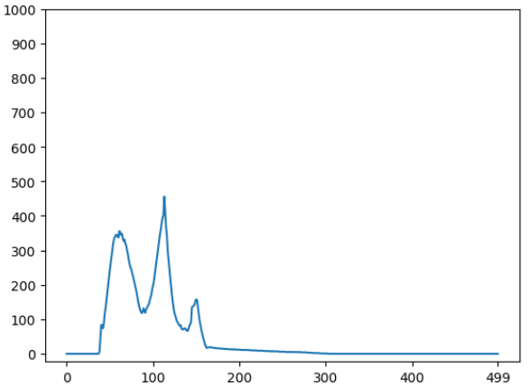

DATASET COLLECTION
Haptics Data:
Using Atmega328P, a custom dataset was created.
The data is classified into three classes: Tap, Smooth and Scratch.
The data is stored in .csv format.
Facial Expression Data
Obtained the data from Kaggle competition.
Data consists of 13,662 sample images belonging to three different classes: Happy, Sad and Angry.
All the images are in grayscale format with size of 48x48 pixels.
SHREYA SALLA PANKAJ

Slide 4
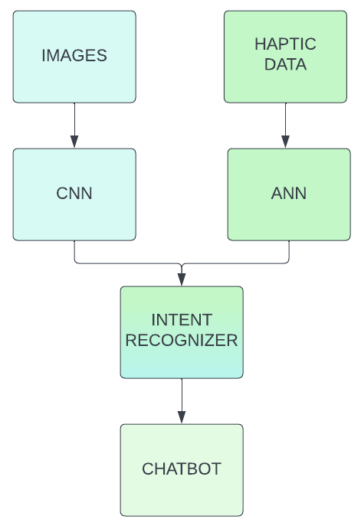
FLOW CHART
CHARAN RAJU

Slide 5
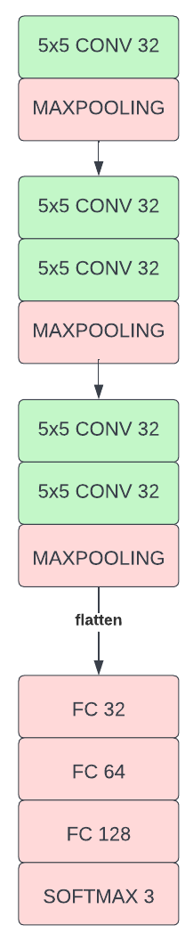
CNN Model
The model consists of 77,411 trainable parameters.
The model uses categorical crossentropy loss function and Adam Optimizer.
The final layer is softmax function to produce the probability of each class.
The model was trained for 70 epochs.
P SAI CHARAN

Slide 6
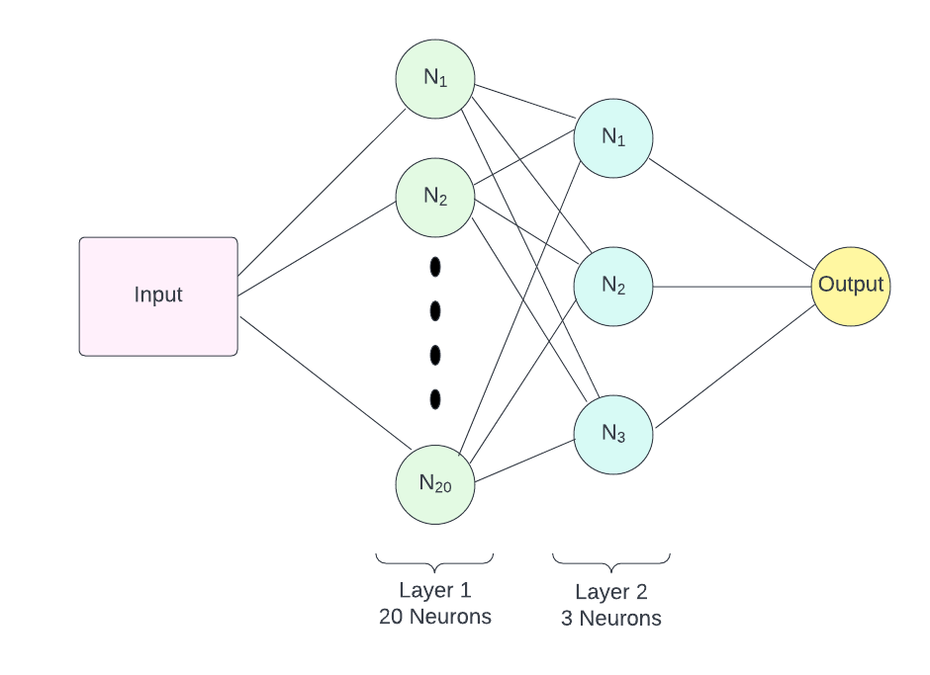
ANN Model
The model consists of 2 Hidden layers.
Layers 1 with 20 neurons and Layer 2 with 3 neurons
The model parameters:
Alpha = 1e-04
Solver = lbfgs
Activation = ReLu
P SAI CHARAN

Slide 7
INTENT RECOGNIZER TABLE
HAPTIC EXPRESSION | TAP | SMOOTH | SCRATCH
HAPPY | SURPRISE | CARING | TICKLE
SAD | DEPRESSED | CONSOLE | REQUEST
ANGRY | HIT | SARCASTIC | ANNOYED
VENKATA KARTHIK DODDA

Slide 8
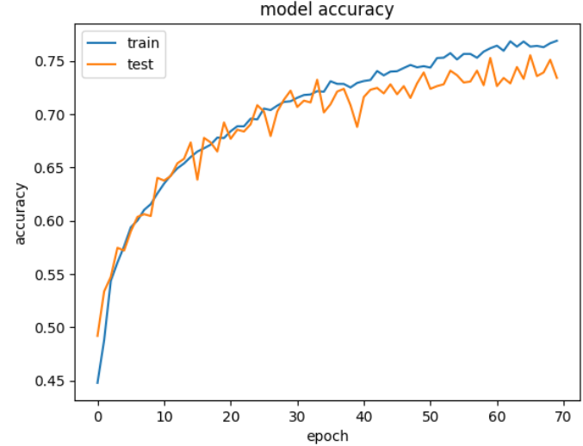
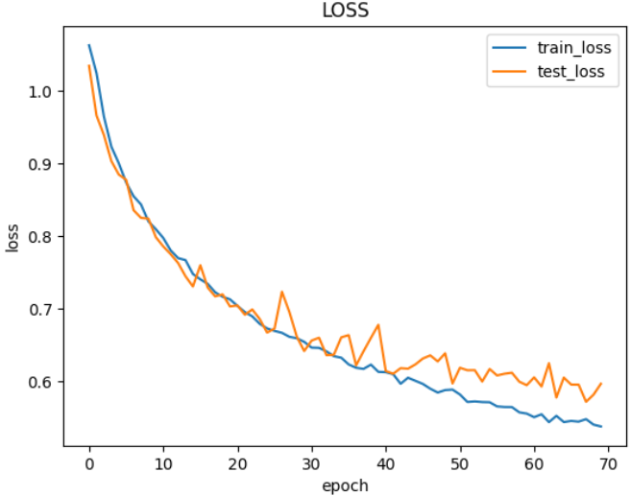
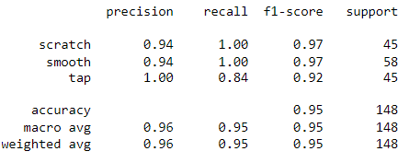
RESULTS
ARCHITA ARUN

Slide 9
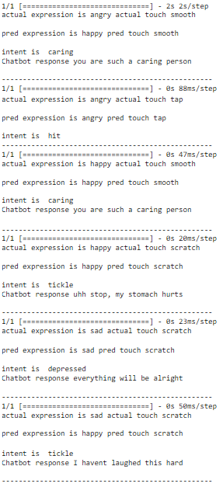
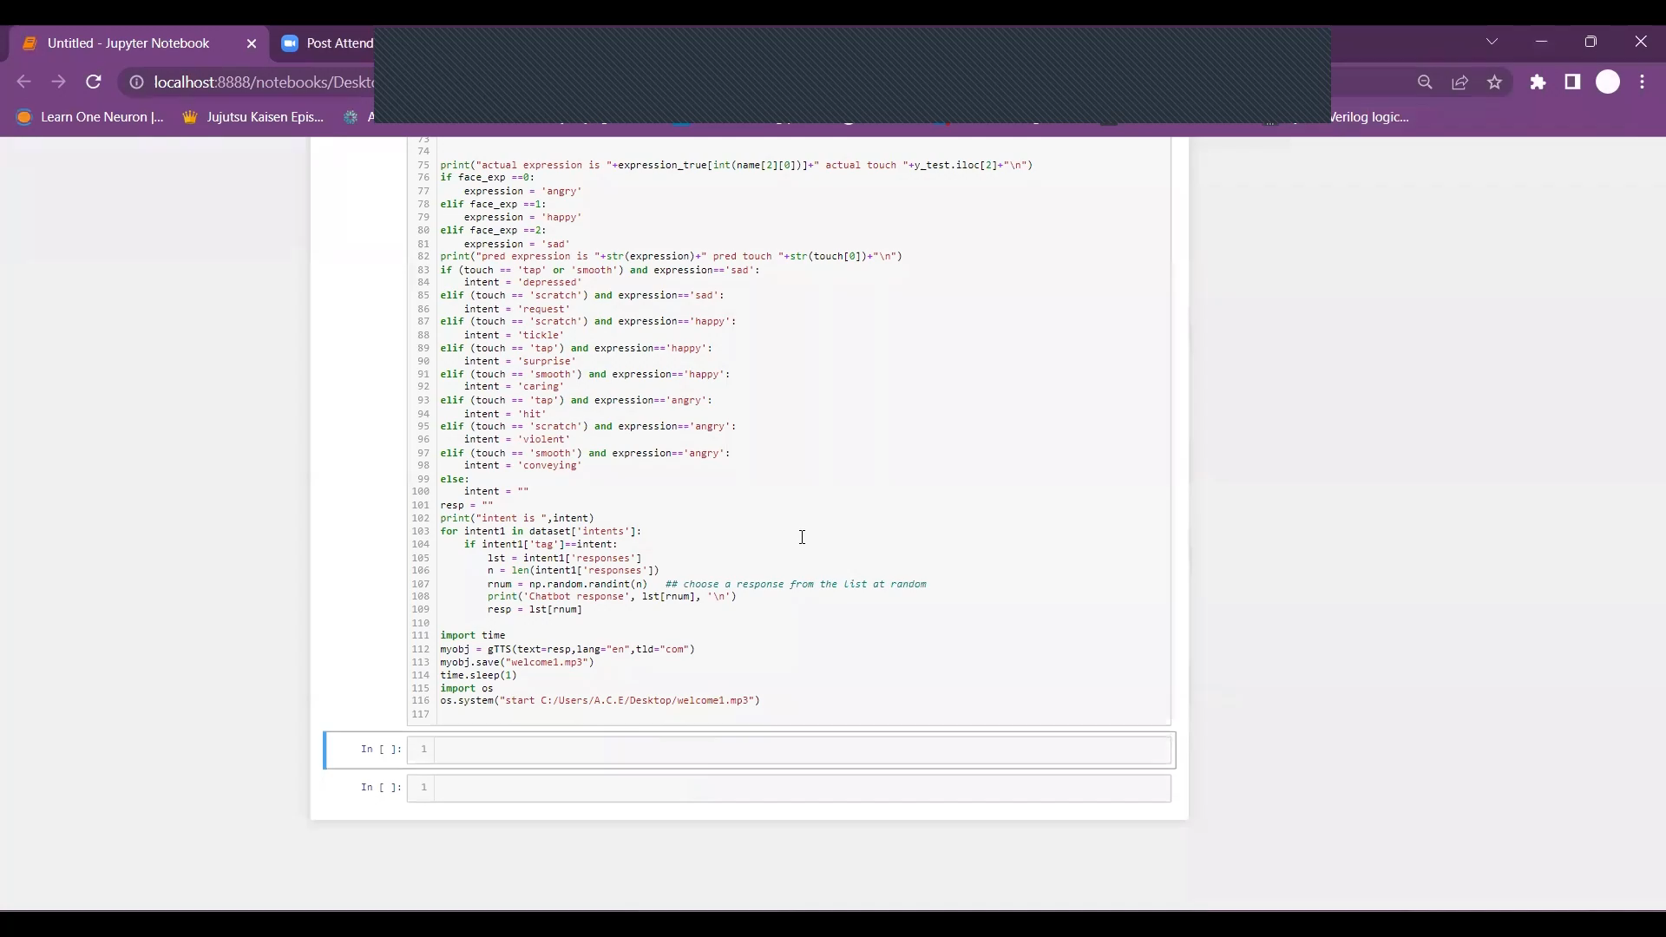
OUTPUT
ARCHITA ARUN

Slide 10
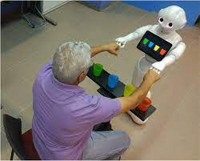
FUTURE SCOPE
Haptic data collection using sensor array and mapping to an image.
This project can be converted into a real time emotion detection.
Combining with speech recognition to accurately obtain the emotion.
Can be deployed into socially assistive robots and pets.
VENKATA KARTHIK DODDA

Slide 11
REFERENCES
https://iopscience.iop.org/article/10.1088/1742-6596/352/1/012045
https://www.researchgate.net/publication/254009843_Improvement_of_the_recognition_of_facial_expressions_with_haptic_feedback
https://www.ncbi.nlm.nih.gov/pmc/articles/PMC6197001/
VENKATA KARTHIK DODDA

Slide 12
THANK YOU
ANY QUESTIONS?

